Slide 1
Computer Number Systems
1-4, 1-5
Add, subtract, multiply divide with Binary
Solve mixed base numbers equations
Copyright © 2020 Legion of Learners. All Rights Reserved.
www.lol-101.com

Slide 2
Homework: Convert any decimal number between 100 and 999 to binary, octal, and hexadecimal
Decimal Number: 783
Copyright © 2020 Legion of Learners. All Rights Reserved.
www.lol-101.com

Slide 3
783→ Binary
783/2= 391 R1
391/2= 195 R1
195/2= 97 R1
97/2= 48 R1
48/2= 24 R0
24/2= 12 R0
12/2= 6 R0
6/2= 3 R0
3/2= 1 R1
1/2 = 0 R1
783→ Binary: 1100001111
Copyright © 2020 Legion of Learners. All Rights Reserved.
www.lol-101.com

Slide 4
783→ Octal
783/8= 97 R7
97/8= 12 R1
12/8= 1 R4
1/8= 0 R1
783→ Octal: 1417
Copyright © 2020 Legion of Learners. All Rights Reserved.
www.lol-101.com

Slide 5
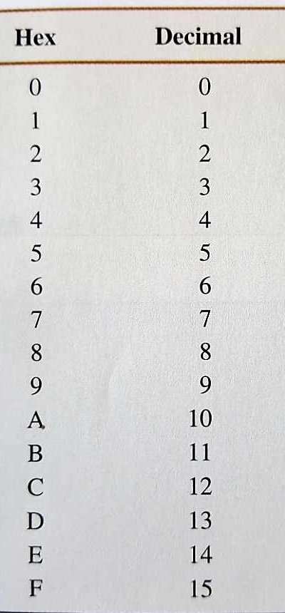
783→ Hexadecimal
783/16= 48 R15→ F
48/16= 3 R0
3/16= 0 R3
783→ Hexadecimal: 30F
Copyright © 2020 Legion of Learners. All Rights Reserved.
www.lol-101.com

Slide 6
Review from Last Meeting:
Computer number systems are special numeric systems with different bases
Helps store data
Convert base 2, 8, 16 to decimal (base 10)
Convert decimal (base 10) to base 2, 8, 16
Copyright © 2020 Legion of Learners. All Rights Reserved.
www.lol-101.com

Slide 7
1-2 How do you convert base 10 numbers to base 2, 8, 16?
Divide the decimal number by the base #, and write down the remainder
Continue dividing the same decimal number until the decimal number is 0
All the digits of the remainder will form the specific number you are looking for
Copyright © 2020 Legion of Learners. All Rights Reserved.
www.lol-101.com

Slide 8
1-3 How do you convert base 2, 8, 16 numbers to base 10 numbers?
Instead of dividing, now you will multiply
Each digit of any computer number system represents a certain amount, based on their base #
For example, in hexadecimal, if you see the number B, you know it represents 12 in decimal
Add up each digit based on the amount it represents
Example: What does the decimal number 25 represent?
The rightmost digit represents only 1s, or (10^0)
The second digit represents 10s, or (10^1)
Copyright © 2020 Legion of Learners. All Rights Reserved.
www.lol-101.com

Slide 9
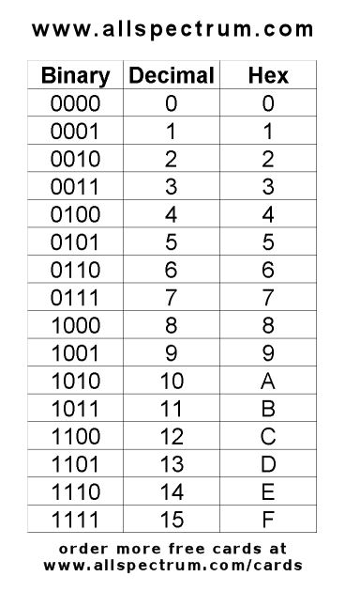
1-4 How do you add binary numbers together?
Binary only has 2 numbers, so 0 → 1→ 10→ 11→ 100
0+1=1, 1+1=10, 1+1+1 = (1+1)+1 = (10)+1 = 11
To add, you would use similar carry-over rules, just like regular addition in decimal:
101+110 = ??? Doesn’t 1+1 = 10 though??
110 110 110 110 110
+101 → +101 →+101 → +101 → +101 → Answer: 1011 ✅
1 11 ??11 1011
__________________________________________________________________________________
11001+1010 = ??? 1 1
11010 11010 11010 11010 11010 11010
+1001 → + 1001 →+ 1001 →+ 1001 → + 1001 →+ 1001 → Answer: 100011✅
1 11 011 0011 100011
Copyright © 2020 Legion of Learners. All Rights Reserved.
www.lol-101.com

Slide 10
1-4 How do you subtract binary numbers?
Subtraction is just reversing addition!
Work backwards from addition
Same rules as regular addition with decimal:
110-101 = ??? If I do 0-1, I will get a negative number! Carry over! 10-1=1
10 10 10 10
110 110 100 100 100 100
-101 → - 101 → -101 →-101 → -101 → -101 → Answer: 1
?? 1 01 001
______________________________________________________________________________
1000-11 = ???
10 10 10 10 10
1000 1000 1000 0000 0100 0110 0110 0110
- 11 → - 11 → - 11 → - 11 → - 11 → - 11 → - 11 →- 11 → Answer: 101
1 0101
Copyright © 2020 Legion of Learners. All Rights Reserved.
www.lol-101.com

Slide 11
1-4 How do you multiply binary numbers together?
Multiplying is even easier, because it is exactly the same as multiplying regular numbers
Multiplying regular numbers, except the numbers only have 1s and 0s
1010*1=???
1010 1010 1010 1010 1010
* 1 → * 1 → * 1→ * 1→ * 1 → Answer: 1010
0 10 010 1010
______________________________________________________________________________
1001*11 = ???
1001 1001 1001 1001 1001 1001 1001 1001
* 11→* 11→* 11→* 11 →* 11→* 11→ * 11 →* 11 →Answer: 11011
1 01 001 1001 1001 1001 1001
1 01 1001 ← Now just add up
Copyright © 2020 Legion of Learners. All Rights Reserved.
www.lol-101.com

Slide 12
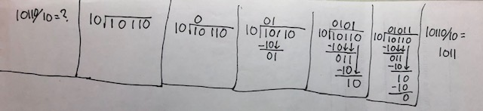
1-4 How do you divide binary numbers?
Again, division in binary uses the same rules as regular division (decimal)
10110/10=???
Copyright © 2020 Legion of Learners. All Rights Reserved.
www.lol-101.com

Slide 13
1011 - 101 = _____
Practice Question
(Binary calculation):
1011 - 101 = _____
Copyright © 2020 Legion of Learners. All Rights Reserved.
www.lol-101.com

Slide 14
(Binary calculation):
1011 - 101 = _____
1011-101=??? 10
1011 1011 1011 0011
- 101 → - 101 → -101→ - 101→ Answer: 110
0 10 10 110
Copyright © 2020 Legion of Learners. All Rights Reserved.
www.lol-101.com

Slide 15
1-5 How do you solve equations with numbers of mixed bases?
Convert each number to one common base
Do your calculations
Convert answer back to the computer number system asked for
Copyright © 2020 Legion of Learners. All Rights Reserved.
www.lol-101.com

Slide 16
Question: 1011(binary) * 99(decimal) = ??? Write your answer in octal form.
We could convert the numbers to any base, as long as both numbers are converted to the same base. In this example, I will convert to decimal
1011(binary) → ??? (decimal)
1*(2^0) + 1*(2^1) + 0*(2^2) + 1*(2^3) = 1+2+0+8=11 (decimal)
Now, we can do our math: 11*99 = 1089 (decimal)
Convert our answer to specified form, if necessary:
1089 (decimal) → ??? (octal)
Copyright © 2020 Legion of Learners. All Rights Reserved.
www.lol-101.com

Slide 17
Question: 1011(binary) * 99(decimal) = ??? Write your answer in octal form. (continued)
Convert our answer to specified form, if necessary:
1089 (decimal) → ??? (octal)
Division | Answer | Remainder
1089/8 | 136 | 1
136/8 | 17 | 0
17/8 | 2 | 1
2/8 | 0 | 2
Answer:
2101 (octal)
Copyright © 2020 Legion of Learners. All Rights Reserved.
www.lol-101.com

Slide 18
Kahoot!
https://create.kahoot.it/share/93a63435-e352-416c-864c-3663758b9654
Copyright © 2020 Legion of Learners. All Rights Reserved.
www.lol-101.com

